Slide 1
Entity-Based Document Classification on the CORD - 19 Corpus
Gollam Rabby and Tomas Kliegr
Department of Information and Knowledge Engineering, VSE University, Prague, Czech Republic
1

Slide 2
Project
Transforming CORD-19 to a flat csv file (e.g. with resources corresponding to columns) to which standard rule learning tools can be applied.
The task is to predict the (academic) success of a paper (as measured by citations).
Since we use an "explainable" machine learning tool, we could find which combination of concepts (e.g. chemical substances) is predictive of paper success.
Sample discovered rules
1

Slide 3
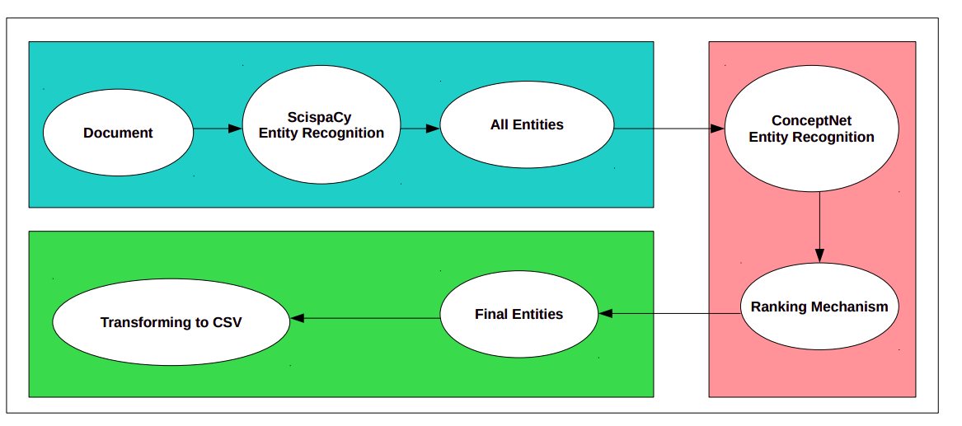
Project - Preprocessing data
1

Slide 4
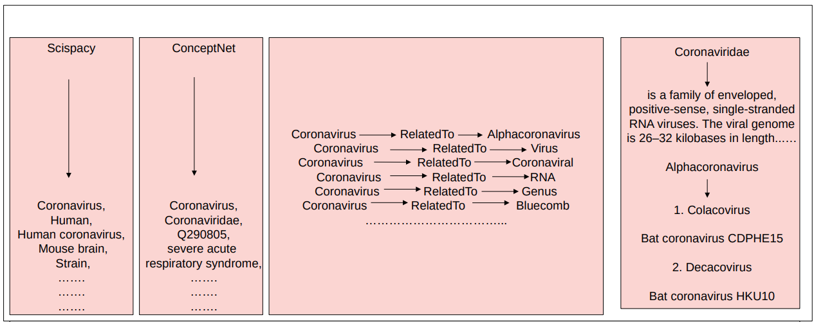
1

Slide 5
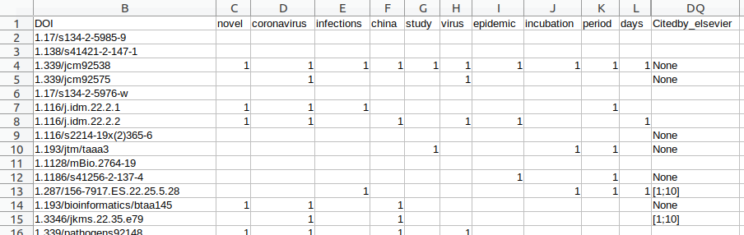
Mining from Tabular: Result of preprocessing
1

Slide 6
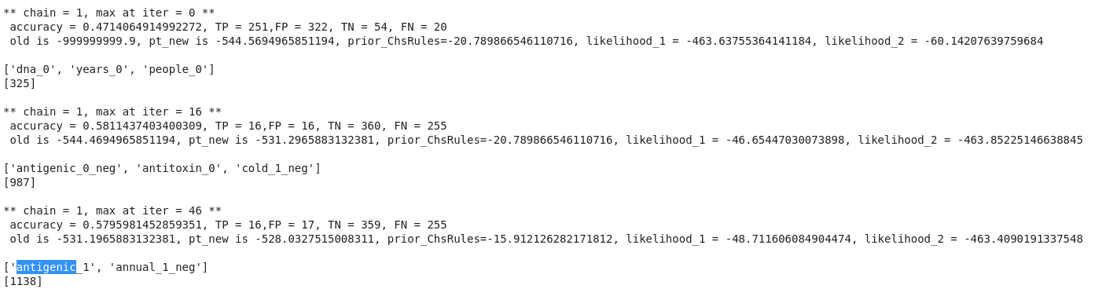
Mining Tabular: Association rule mining with Bayesian Rule Set mining
1

Slide 7
Summary
Feedback appreciated
We would appreciate any pointers to code in the Jupyter notebook, particularly:
1. Ways to generate higher quality entities, assign weights to entities, remove uninteresting entities. Currently, we have experimented with Scispacy, ConceptNet, Scispacy with ConceptNet and TF-IDF model.
2. We use a number of citations (OpenCitations Ontology) as a proxy of the significance of results reported in the paper. Do you have a better suggestion?
1

Slide 8
Future Work
1.Building a knowledge graph (KG)
2. Prediction of missing triples in KG
3. Classification in KGs
4. Clustering of similar rules
1

